Slide 1
The Beauty of Linux

Slide 2
Linux
An amazing OS, made by Linus Torvalds in 1991.
Since then it evolved into a must to have operating system on any device

Slide 3
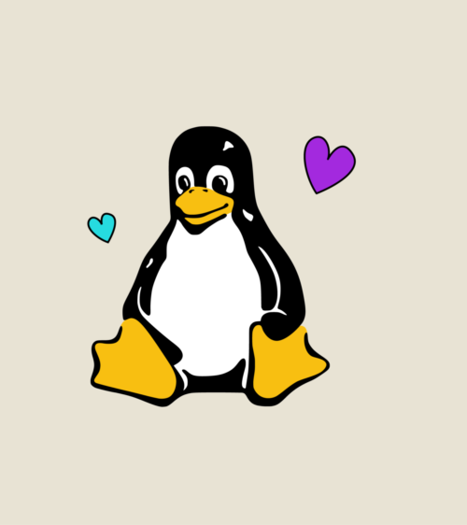
Customizations

Slide 4
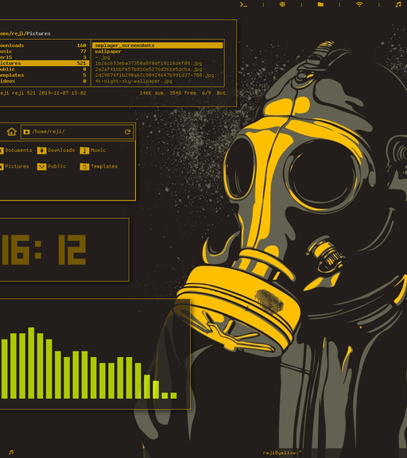
Linux can be customized through varies tools and ways it’s called “rice”

Slide 5

Thank you
Abdullah Al-Banna
abdullah@albannatech.com

